Slide 1
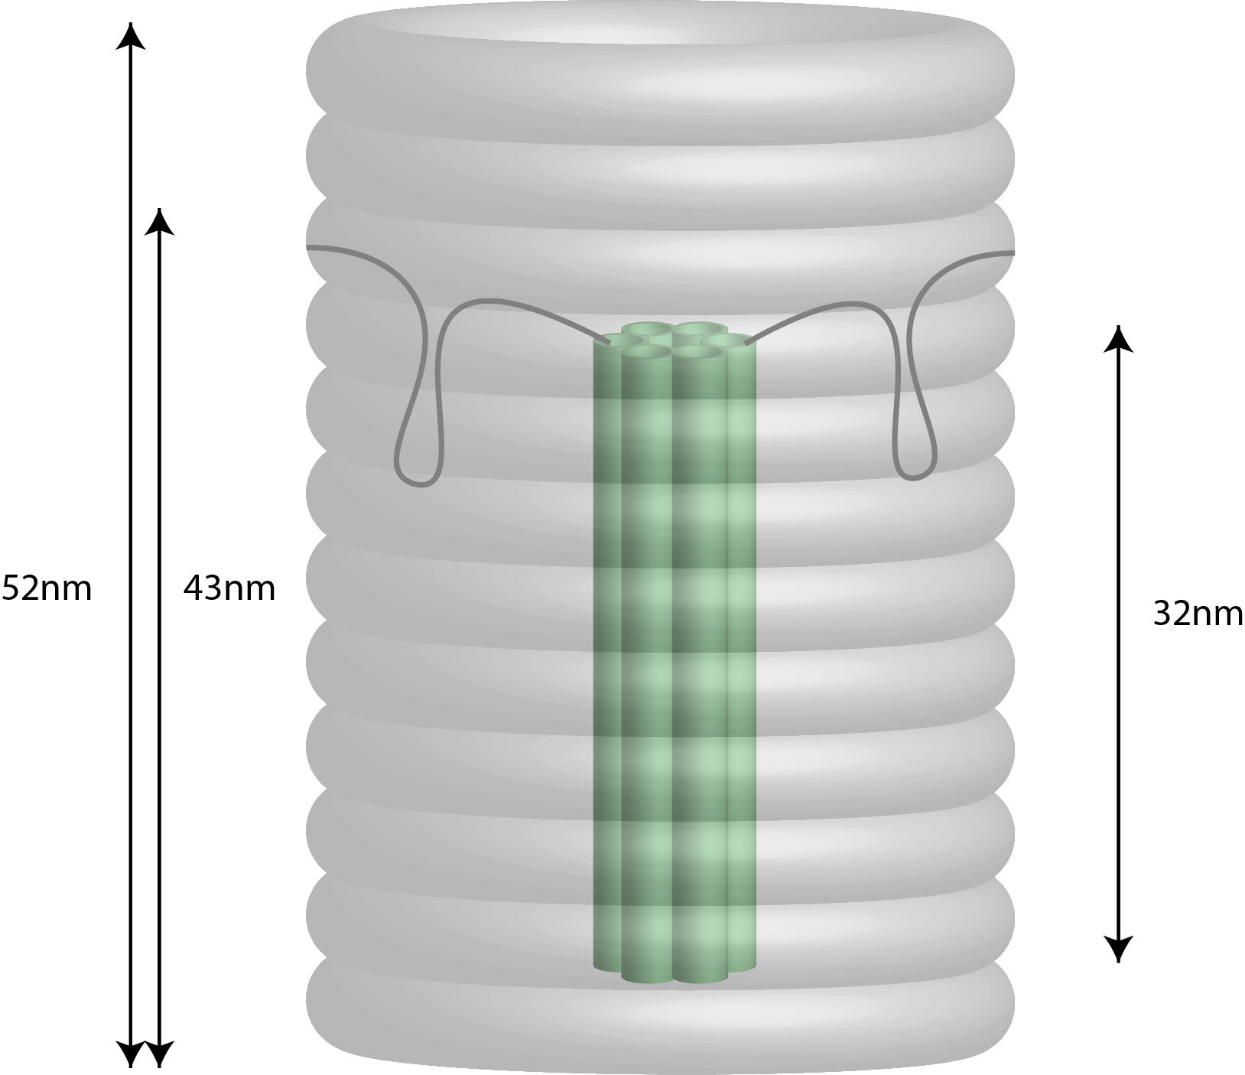
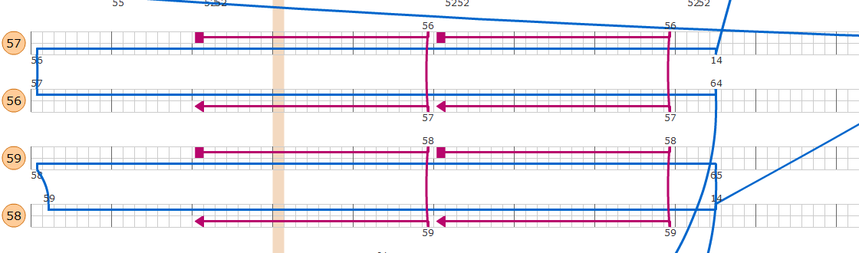
Current design
Cinches don’t work!

Slide 2
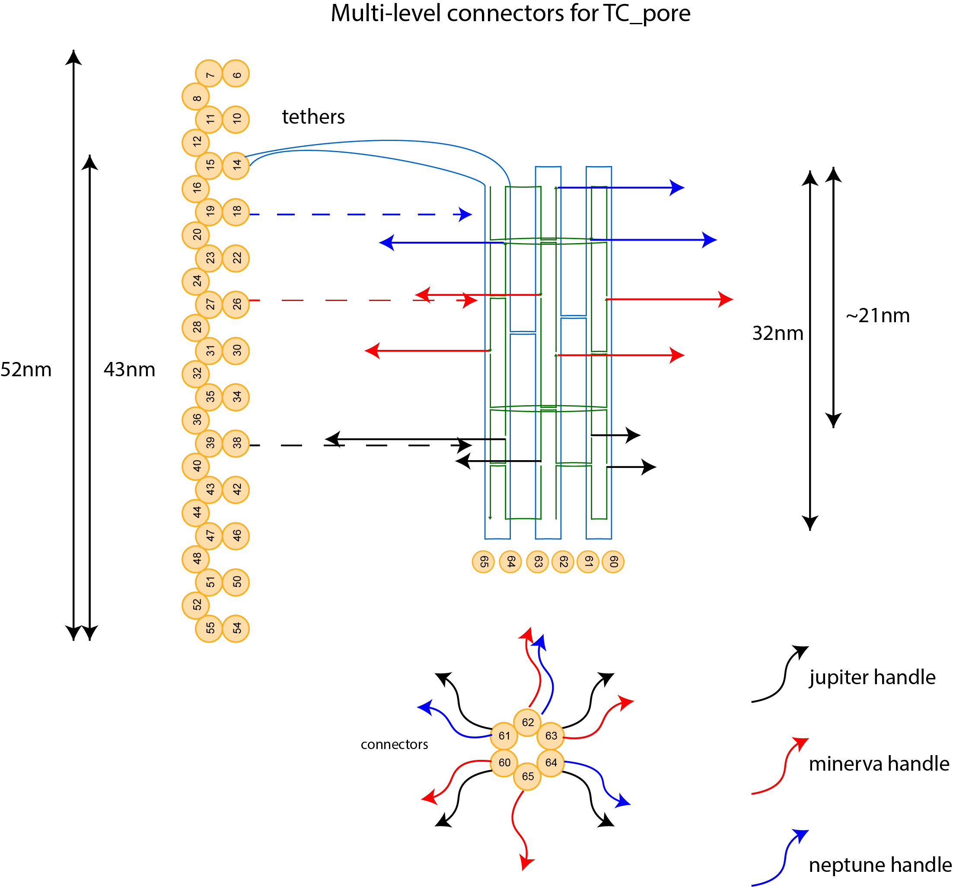
Current design
With 1 level of connectors (black) - 40% of pore are hidden
With 3 level of connectors - 70% of pore are hidden

Slide 3
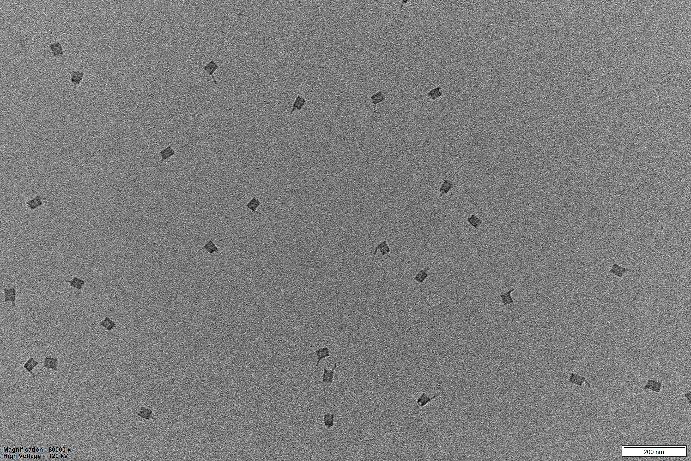
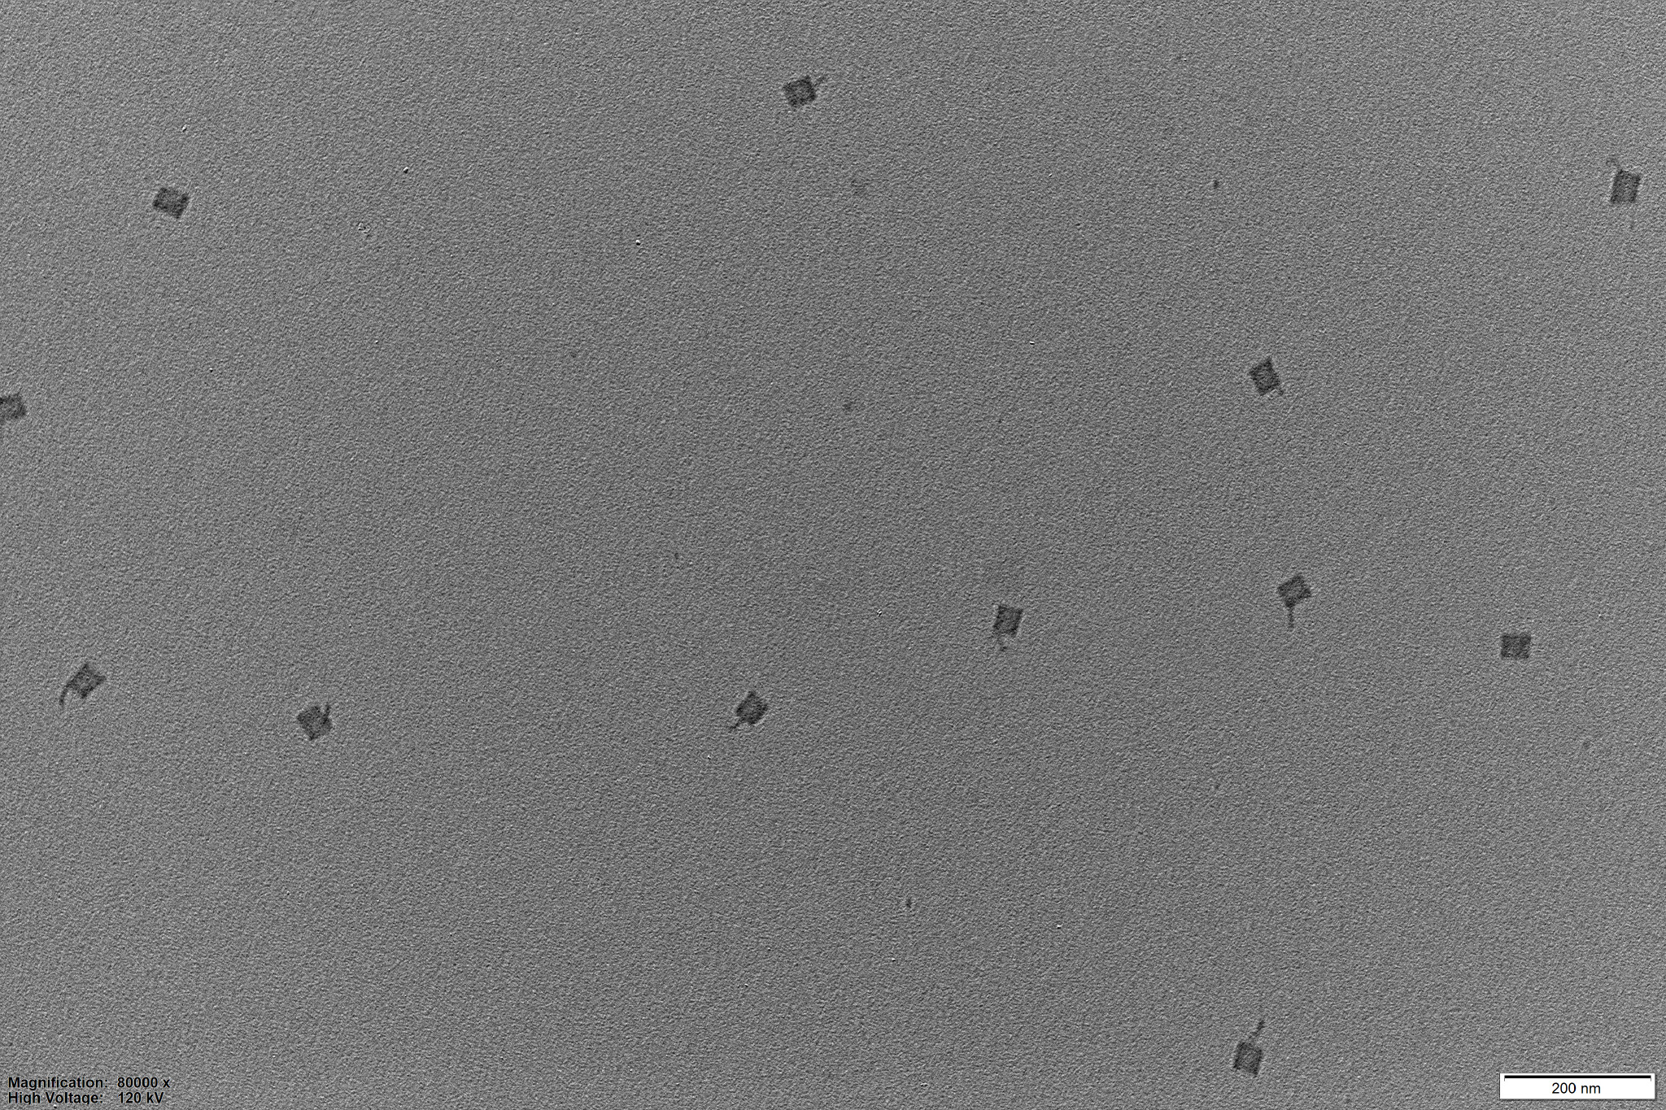
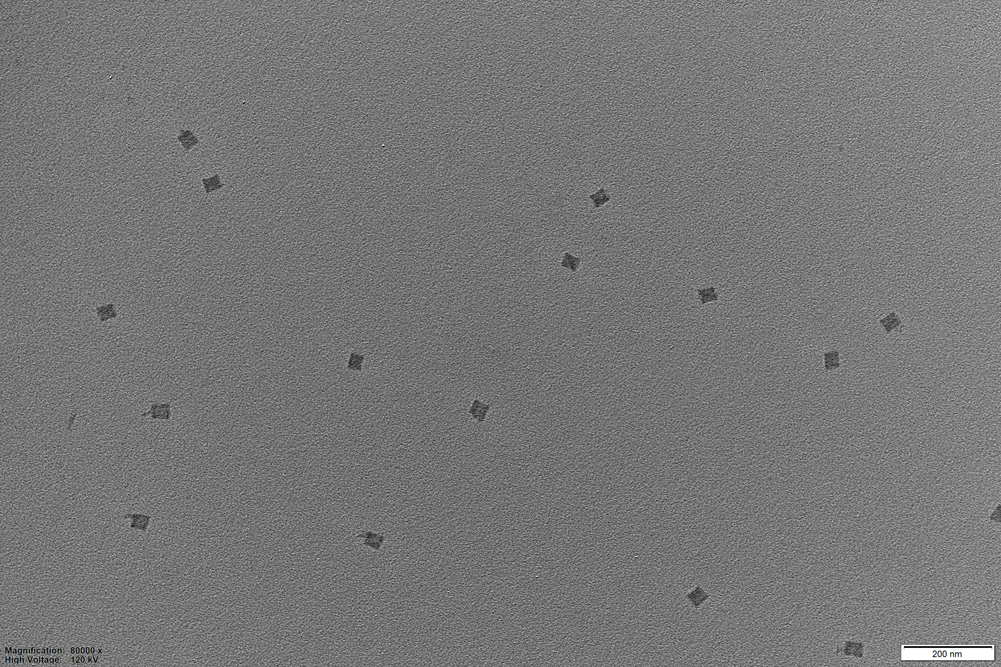
Current design
0 connectors
1 connector
3 connectors
No connectors - 0-10% of pore are hidden
1 level of connectors (black) - 40% of pore are hidden
3 level of connectors (blue, red, black) - 70% of pore are hidden

Slide 4
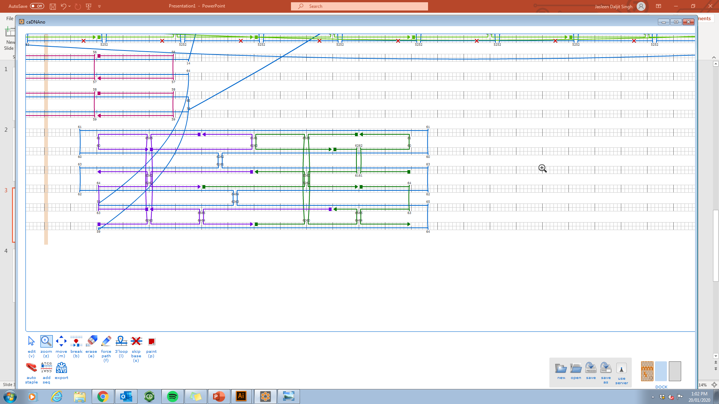
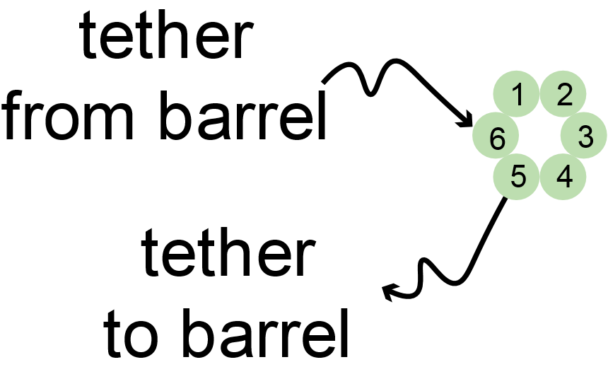
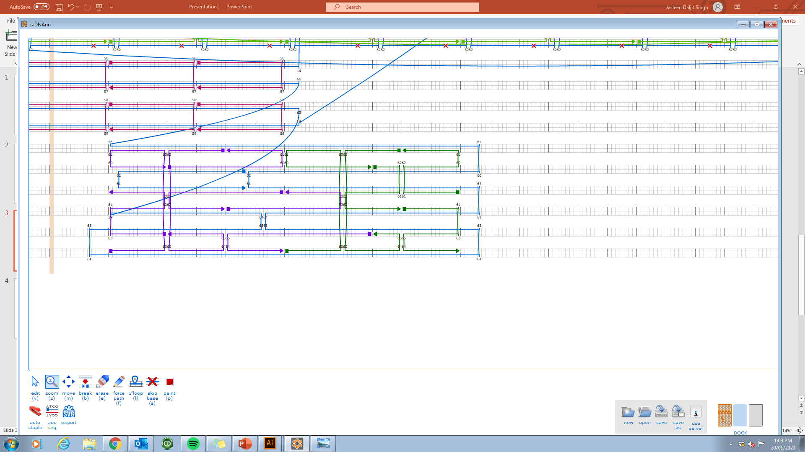
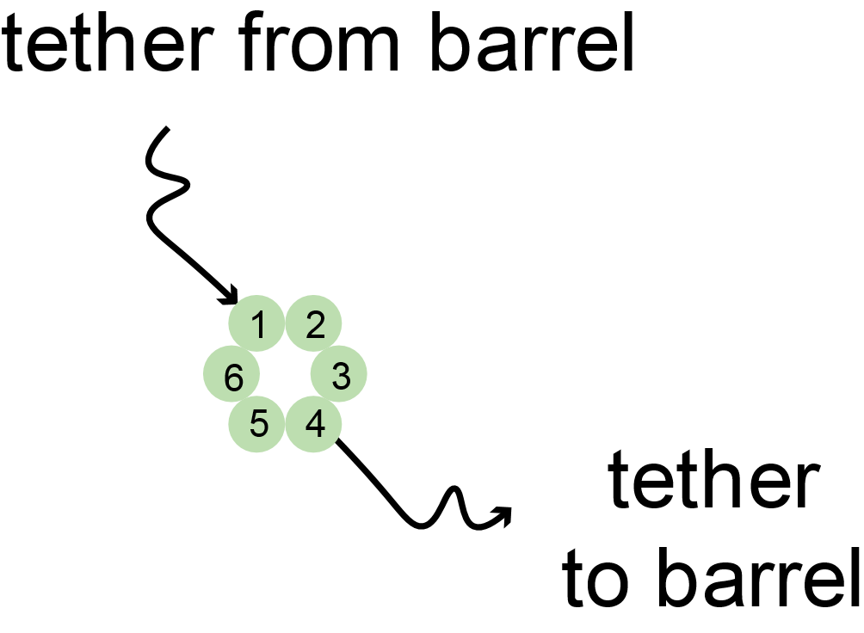
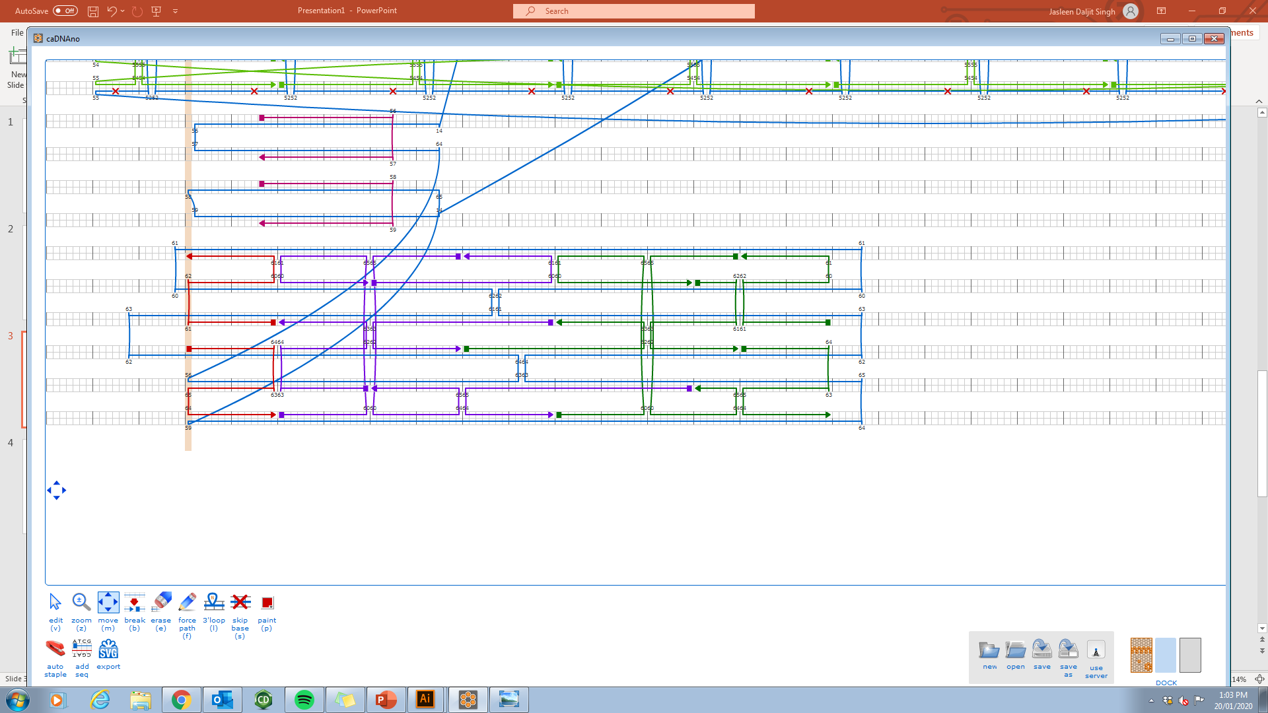
Different pore designs
TC_pore
TC_SSpore
TC_Lpore

Slide 5
What we could investigate
Is it possible to model the different number of connectors
(maybe also different positions of the connector on the barrel)
Different tether lengths - how mobile is the pore?
Tether coming out from different parts of the pore (TC_pore vs TC_SSpore) - how mobile is the pore?
MAGICDNA – pore folding inside/outside of barrel?

